Slide 1
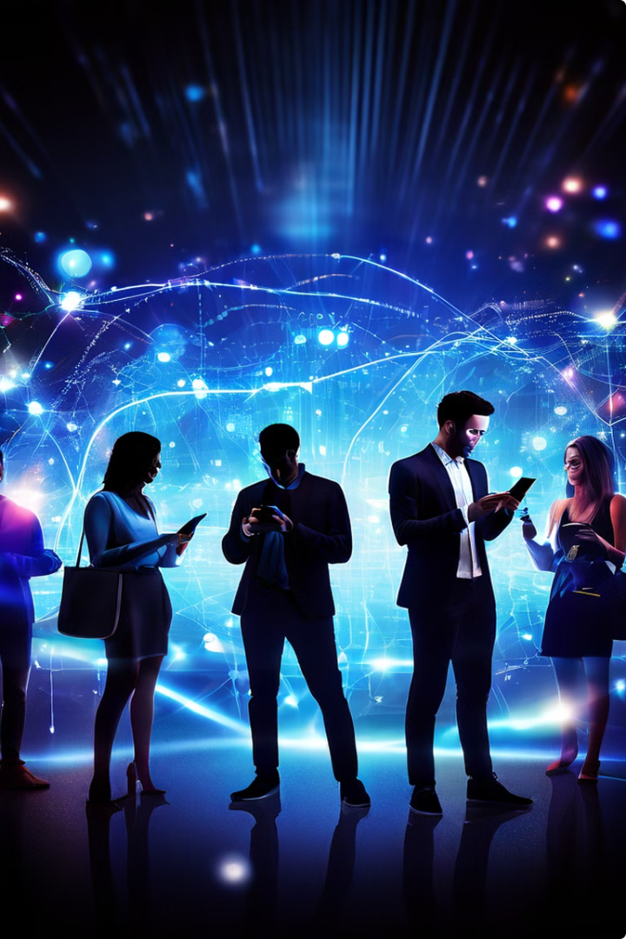
TT
Social Media and Technology: Shaping Modern Society
Social media and technology have become integral components of modern society, impacting various aspects of daily life, from communication and relationships to education and business. Understanding their importance is crucial for comprehending how they shape individual behaviors, societal norms, and global interactions. This research explores the influence of social media on public opinion, methodologies for studying its effects, and key challenges and future directions in this rapidly evolving field.
Talha Abbas Shaikh
VR512332

Slide 2
The Evolution of Technology
The history of technology is a story of innovation and transformation that has significantly shaped human civilization. From the invention of the wheel to the development of the internet, technological advancements have driven progress in various fields, leading to the modern digital age. These innovations have revolutionized communication, social interactions, and access to information, creating a landscape ripe for research across various disciplines.
1
2
3
4
Ancient Innovations
Industrial Revolution
Digital Age
Social Media Era
The invention of computers and the internet ushered in an era of unprecedented connectivity and information access.
Platforms like Facebook and Twitter revolutionized communication and social interaction on a global scale.
Early technological advancements like the wheel and writing systems laid the foundation for human progress.
Mechanization and mass production transformed society, leading to rapid economic and social changes.

Slide 3




Influence of Social Media on Public Opinion
Social media platforms have a significant influence on public opinion by providing a space for individuals to share information, express opinions, and engage in discussions. These platforms can amplify voices, spread news rapidly, and create echo chambers where users are exposed primarily to views that align with their own. This process affects how people perceive and interpret various social, political, and economic issues, shaping public discourse and societal attitudes.
Information Sharing
Amplification
Echo Chambers
Opinion Formation
Content gains traction through likes, shares, and comments.
Algorithms reinforce existing beliefs by showing similar content.
Users share news, opinions, and experiences on social platforms.
Users form or modify views based on social media exposure.

Slide 4
Research Methodology: Data Collection and Analysis
To comprehensively study the impact of social media and technology, a mixed-methods approach is employed, combining both qualitative and quantitative research methods. Data collection methods include surveys, interviews, focus groups, and social media content analysis. This multi-faceted approach allows researchers to gather rich, diverse data on user experiences, behaviors, and attitudes towards social media and technology.
Quantitative Methods
Qualitative Methods
Mixed Methods
Surveys
Interviews
Triangulation
Social media analytics
Focus groups
Sequential explanatory design
Big data analysis
Content analysis
Concurrent nested design

Slide 5




Types of Analysis in Social Media Research
Various analytical techniques are employed to extract meaningful insights from the collected data. These include statistical analysis, thematic analysis, network analysis, sentiment analysis, and comparative analysis. Each method offers unique perspectives on social media usage patterns, user behaviors, and the broader societal impacts of these technologies.
Statistical Analysis
Network Analysis
Sentiment Analysis
Comparative Analysis
Using tools like SPSS and R for descriptive and inferential statistics.
Studying social connections and influence patterns within platforms.
Gauging public sentiment and emotional tone in social media content.
Identifying changes and differences in social media usage over time or between groups.

Slide 6
Impact of Social Media and Technology
The interplay between social media and technology has reshaped various aspects of modern life, influencing how individuals interact, share information, form opinions, and perceive themselves. These platforms have become powerful tools for education, business, and social movements, driving innovation and societal change. However, they also present challenges such as data privacy concerns, misinformation spread, and potential negative psychological impacts.
Global Connectivity
Information Access
Facilitating relationships and connections across distances.
Democratizing knowledge and enabling rapid information sharing.
Business Opportunities
Mental Health Concerns
Enhancing marketing, customer engagement, and e-commerce.
Potential links to anxiety, depression, and addiction in some users.

Slide 7
Challenges and Future Directions
Addressing the challenges posed by social media and technology requires a multi-faceted approach. Key areas of focus include educating users on ethical use and data privacy, implementing stronger security measures, developing interventions for negative psychological impacts, and designing algorithms that promote diverse perspectives. Future research and development should prioritize user well-being, privacy protection, and the creation of more inclusive digital environments.
1
Digital Literacy Education
2
Privacy Protection
Promoting critical thinking and ethical use of social media platforms.
Developing stronger data security measures and transparent collection practices.
3
Mental Health Interventions
4
Algorithmic Fairness
Creating resources to mitigate negative psychological impacts of social media use.
Designing systems that reduce echo chambers and promote diverse viewpoints.

Slide 8
Conclusion: Balancing Benefits and Risks
Social media and technology have profoundly transformed communication, interaction, and daily life. While offering immense benefits in connectivity, information access, and opportunities for education and business, they also present significant challenges. Balancing the advantages with ethical considerations and safeguarding against potential harms is crucial. Ongoing research, policy development, and technological innovation are essential to harness the positive potential of social media and technology while mitigating their risks.
Benefits
Risks
Global connectivity
Privacy concerns
Information access
Misinformation spread
Educational opportunities
Cyberbullying
Business growth
Addiction potential

Slide 9
Bibliography:
Boyd, D. (2014). It's Complicated: The Social Lives of Networked Teens.
Ellison, N. B., & Boyd, D. (2013). Sociality through Social Network Sites.
Turkle, S. (2011). Alone Together: Why We Expect More from Technology and Less from Each Other.
Hampton, K. N., Sessions, L. F., & Her, E. J. (2011). Core Networks, Social Isolation, and New Media: How Internet and Mobile Phone Use is Related to Network Size and Diversity.
Chou, H. T. G., & Edge, N. (2012). “They Are Happier and Having Better Lives than I Am”: The Impact of Using Facebook on Perceptions of Others' Lives.
Andreassen, C. S., Torsheim, T., Brunborg, G. S., & Pallesen, S. (2012). Development of a Facebook Addiction Scale.
Kaplan, A. M., & Haenlein, M. (2010). Users of the World, Unite! The Challenges and Opportunities of Social Media.
Livingstone, S. (2008). Taking Risky Opportunities in Youthful Content Creation: Teenagers' Use of Social Networking Sites for Intimacy, Privacy, and Self-Expression.
Papacharissi, Z. (2011). A Networked Self: Identity, Community, and Culture on Social Network Sites.
Vaidhyanathan, S. (2018). Antisocial Media: How Facebook Disconnects Us and Undermines Democracy.

